Slide 1

Factors that Predict Trending YouTube Videos in 2018
Team Members: Craig Washington, Kelsie Hargita, Jeremy Hamley, Hannah Wang, Ankit Baboota
Notes:
Craig

Slide 2
Motivation
“If I posted this video, will it trend?”
“How do I become a YouTube influencer?”
We were interested in what makes YouTube videos trend.
The project aims to explore patterns of trending YouTube video and factors that affect whether a video trends or not.
Our hypothesis is that factors such as publishing day of week, number of subscribers, etc. affect whether a video trends.
Notes:
Craig

Slide 3
Summary
Most trending videos:
Had a median of 350k views, 10k likes, 300 dislikes, and 1k comments
Were posted on weekdays
Were posted between 12PM and 3PM
Had 0 or 1 tag
Were part of the entertainment category
Trended within 3 days of being posted and trended for less than a week
Are not dependent on the channel’s subscriber count
Notes:
Craig

Slide 4
Research Questions
Our group explored the following factors:
Summary statistics of number of comments, likes, subscribes, views, etc.
Day of the week when video was posted
Days from publishing to trending
Time of day when video was posted
Number of tags used
Category of video
Subscriber count of publisher
Total number of videos posted by publisher
Total views of publisher’s channel
Notes:
Craig

Slide 5
Data Source
YouTube API https://developers.google.com/youtube/v3/getting-started
Kaggle’s Trending YouTube Video Statistics dataset https://www.kaggle.com/datasnaek/youtube-new
Methodology: https://github.com/mitchelljy/Trending-YouTube-Scraper
Notes:
Craig

Slide 6
Data Cleanup
Removed unnecessary columns (e.g. description)
Created functions
count number of tags
separate trending and publish time into usable formats
Removed duplicated videos using title (video_id had missing data)
Organized original dataframe by unique channel title and video id
Dropped rows that contained no channel statistics
Notes:
Ankit

Slide 7
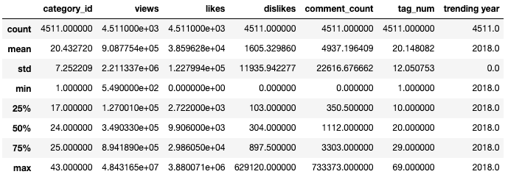
Data Exploration
Median Views: 349,033
Median Likes: 9,906
Median Dislikes: 304
Median Comment Count: 1,112
There were trending videos that had no likes, dislikes, or comments!
Notes:
Hannah
.describe() to see distribution of data and measure of central tendency

Slide 8
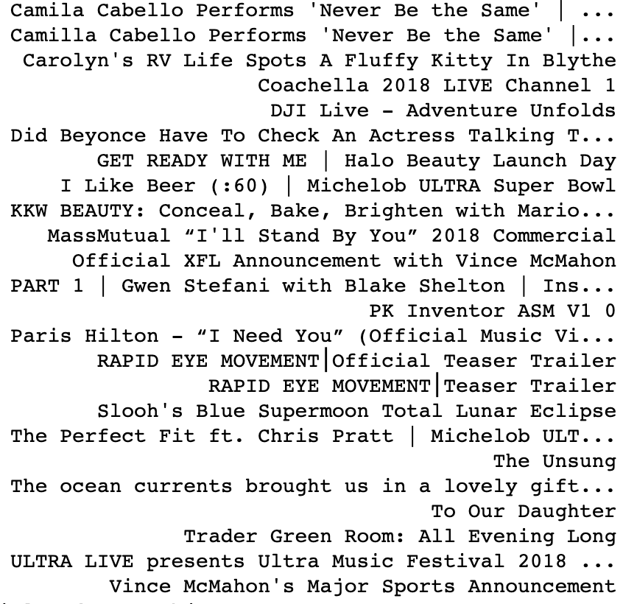
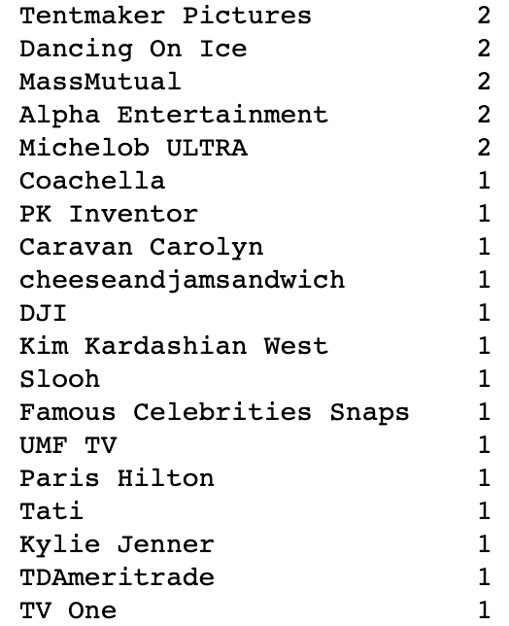
Data Exploration Cont.
Videos with no likes, dislikes, or comments
Channels of these videos

Slide 9
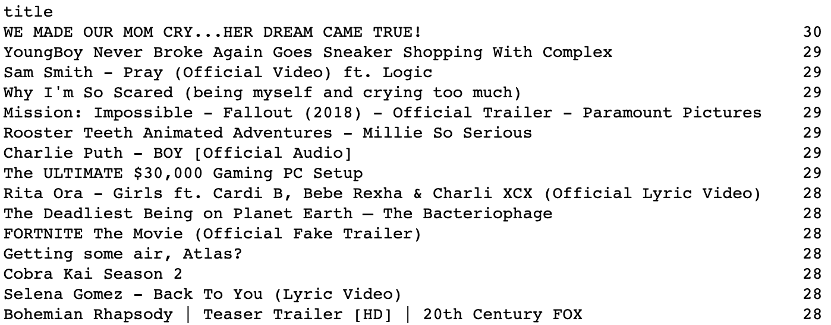
Data Exploration Cont.
4,048 videos were duplicated because they continued to trend when data was pulled
Notes:
Hannah
youtube_2018_df.groupby('title').count()['video_id'].sort_values(ascending=False)

Slide 10
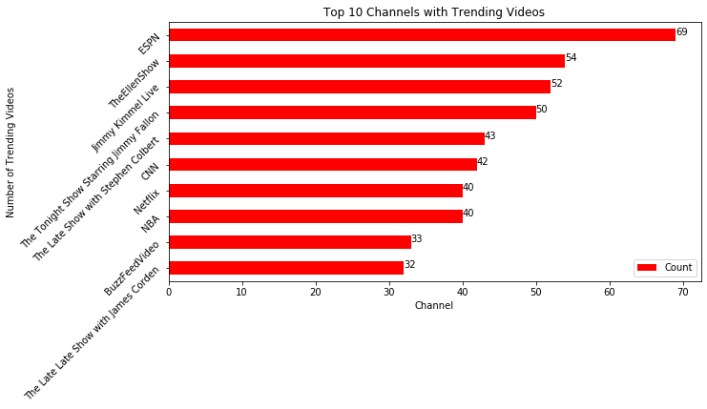
Data Exploration Cont.
Notes:
Hannah

Slide 11
Data Analysis

Slide 12
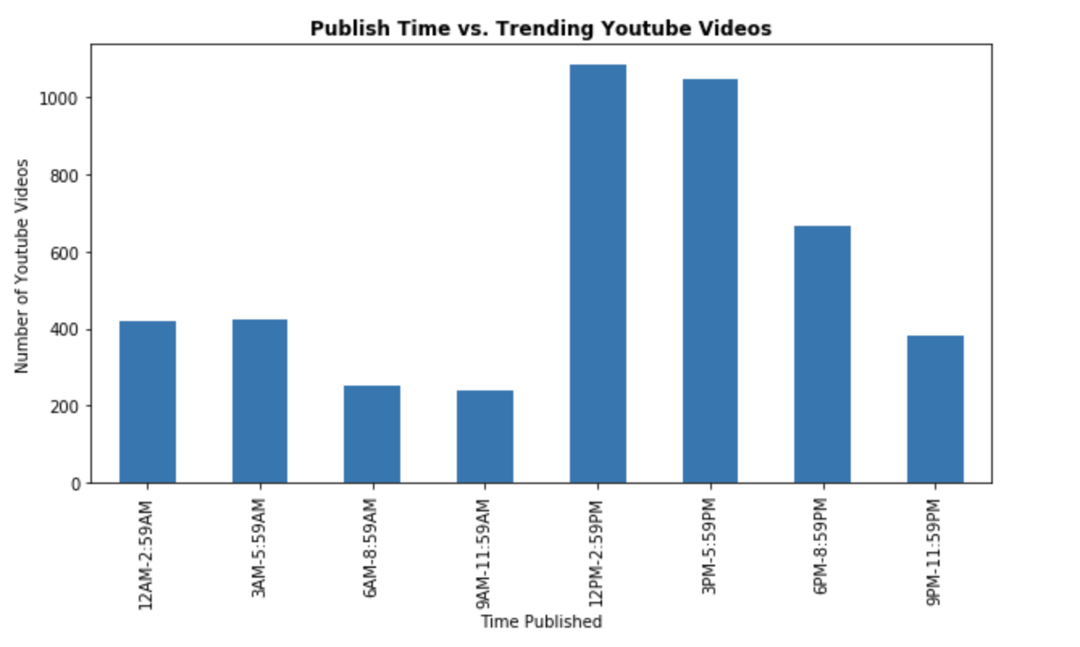
What time of day are trending videos published?
Notes:
Kelsie

Slide 13
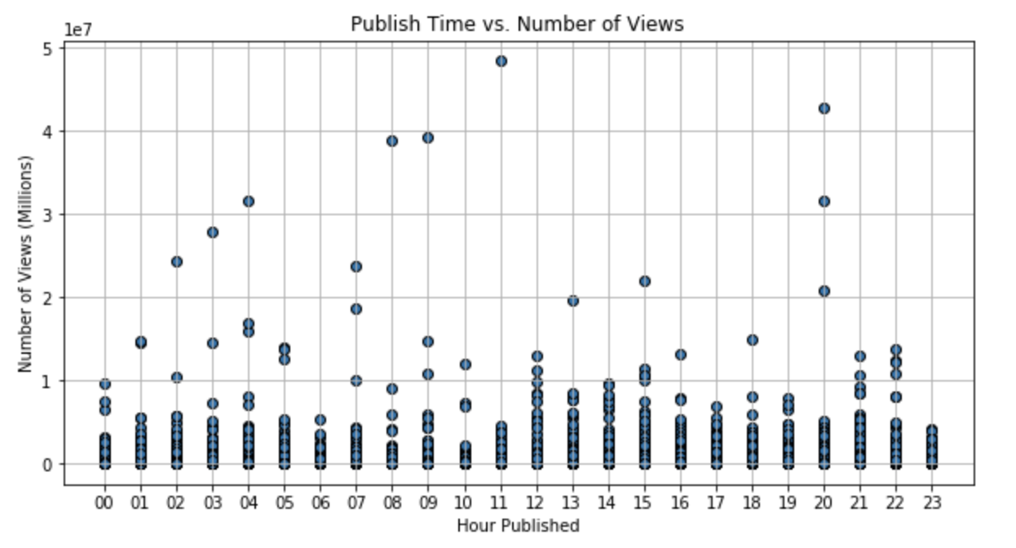
Does the publishing time affect the number of views?
Notes:
Kelsie

Slide 14
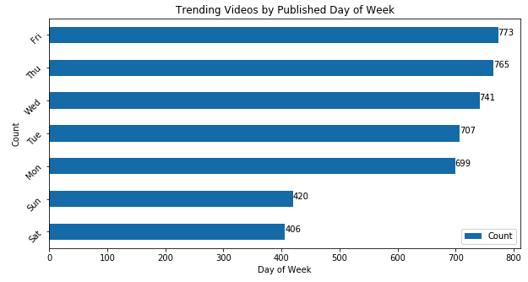
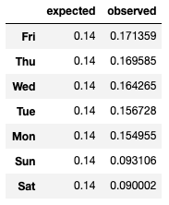
What days of the week are trending videos published?
X x x
Notes:
Hannah

Slide 15
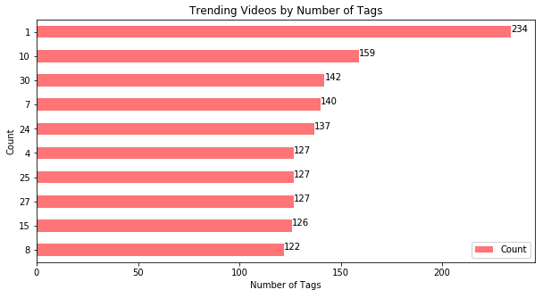
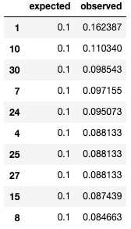
How many tags were used in trending videos?
Notes:
Hannah

Slide 16
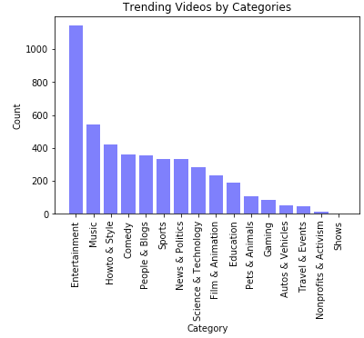
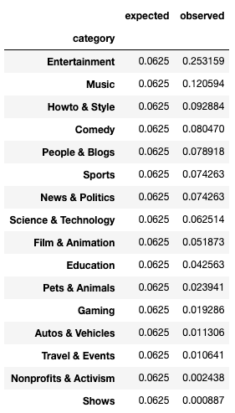
What category of videos trends most?
Notes:
Hannah

Slide 17
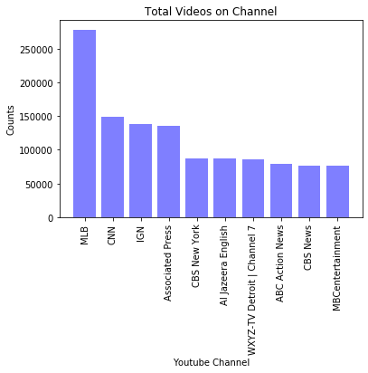
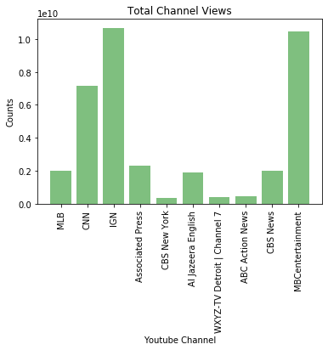
Does Uploading Multiple Vids affecting View count?
Notes:
Craig
These are the top 10 Channels that uploaded the most videos on the left. As you can see just because you upload a lot of videos doesn’t mean your videos will trend the most. The MLB channel has the most videos, but yet it has one of the smallest amounts of views for a channel. In fact, the channel with the most amount of views has the lowest amount of videos uploaded. I would want to say it's quality over quantity when it comes to content, but comparisons are to sporadic to make this assumption. Most of the channels that post most seem to be news affiliates and may contain very short news briefings and single clips. Lots of people may not in general would be interested in that vs something that may be entertaining

Slide 18
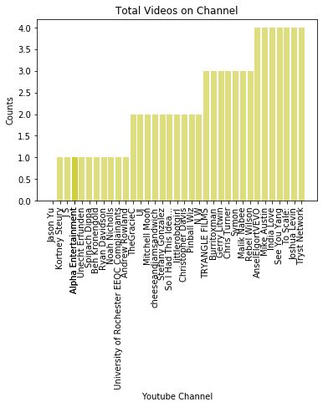
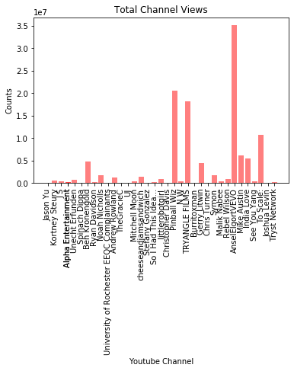
Does Uploading Multiple Vids affecting View count? - lowest vids uploaded
Notes:
Craig

Slide 19
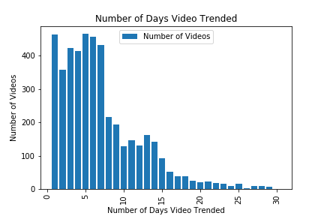
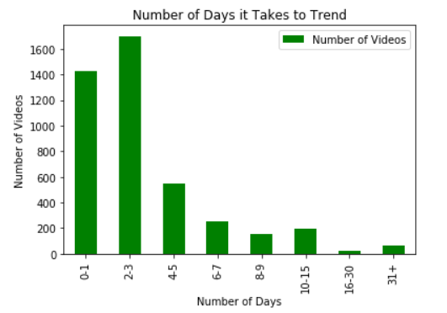
How many days does it take to trend?
Notes:
Jeremy
How many days does it take a video to trend from the day it was posted?
Once a video trends, how long does the trend last?

Slide 20
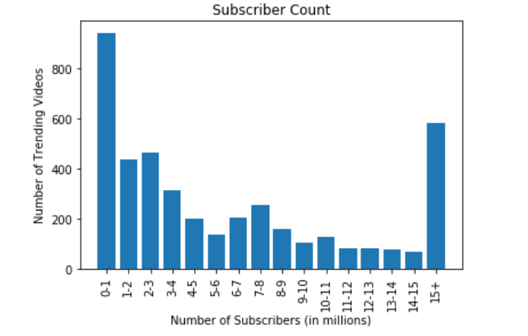
Does having more subscribers affect a videos ability to trend?
Notes:
Ankit
Mean = 7,126,761
There are 2,767 videos below the mean

Slide 21
Discussion
We found that although some of our findings aligned with our expectations, a few of them caught us by surprise.
General conclusions:
Trending videos generally had around 350k views and 10k likes
Having more subscribers does not help a video trend
Using more tags doesn’t necessarily help videos trend
Trending videos were usually posted on a weekday
The entertainment category had most trending videos
The time posted doesn’t significantly affect the number of views
The volume of videos uploaded to a channel does not impact whether or not your channel will have views.
If a video has not trended within 3 days of being posted, then the video will probably not trend.
Notes:
Kelsie

Slide 22
Limitations
Data pulled for subscriber count, channel total views, total videos posted from channel was from 2020 (even though other data was from 2018)
The way the 2018 data was pulled, trending videos were duplicated if they continued to trend over several days
Chose the row with the earliest trending date to subset unique trending videos
Videos with no tags were counted as having 1 tag due to function using text split
Notes:
Jeremy

Slide 23
Future Analysis
Other factors that can be explored in future studies:
length of video
Description text
video titles (i.e. What were the most common words in trending titles?)
verified account badge
Are the factors that affect trending videos different in different countries?
Do statistical trends vary from one year to the next?
Outside influences: What drove someone to search for a video?
Notes:
Jeremy

Slide 24

Q&A

